Slide 1
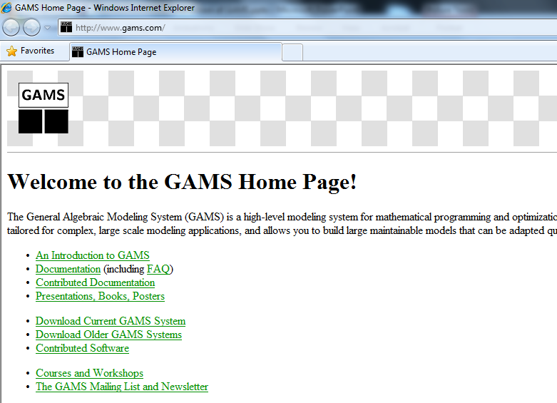
How to download GAMS?
www.gams.com
Download Current GAMS System

Slide 2
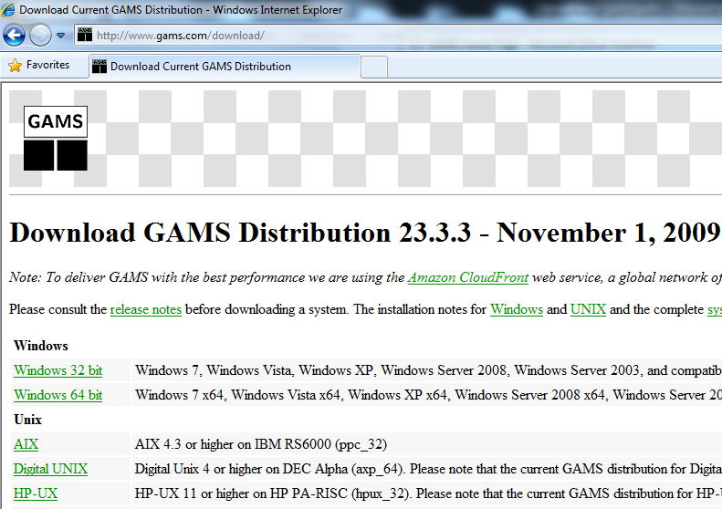
How to download GAMS?

Slide 3
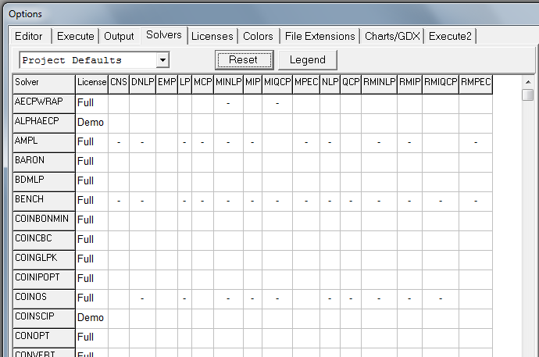
Limitation of Solver

Slide 4
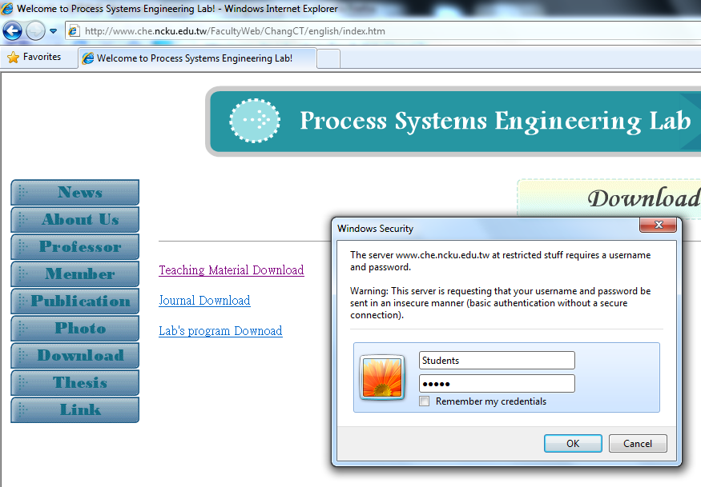
How to download GAMS Tutorial?
www.che.ncku.edu.tw/Faculty/ChangCT

